Slide 1
Switch
Group 4

Slide 2
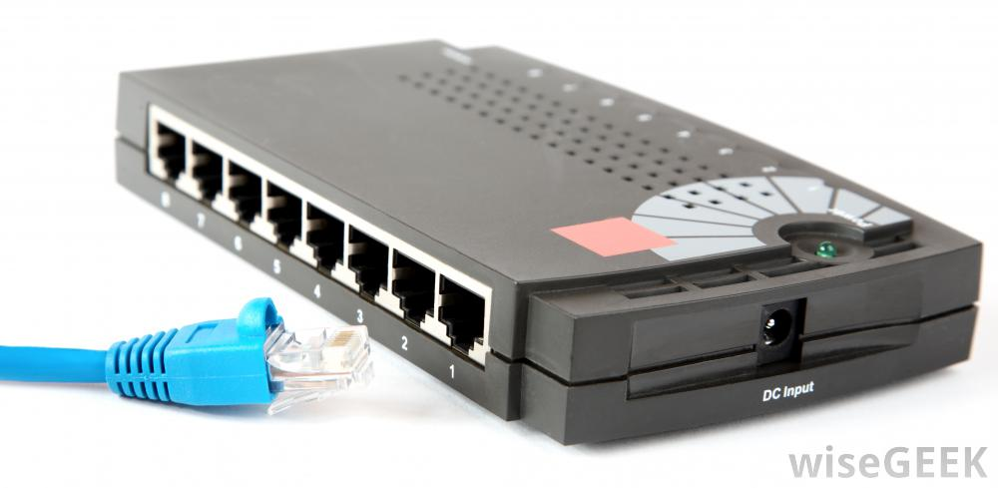
SWITCH PORT
Switch ports are Layer 2-only interfaces associated with a physical port. A switch port can be an access port, a trunk port, or a tunnel port.
Switch ports are used for managing the physical interface and associated Layer 2 protocols and do not handle routing or bridging.

Slide 3
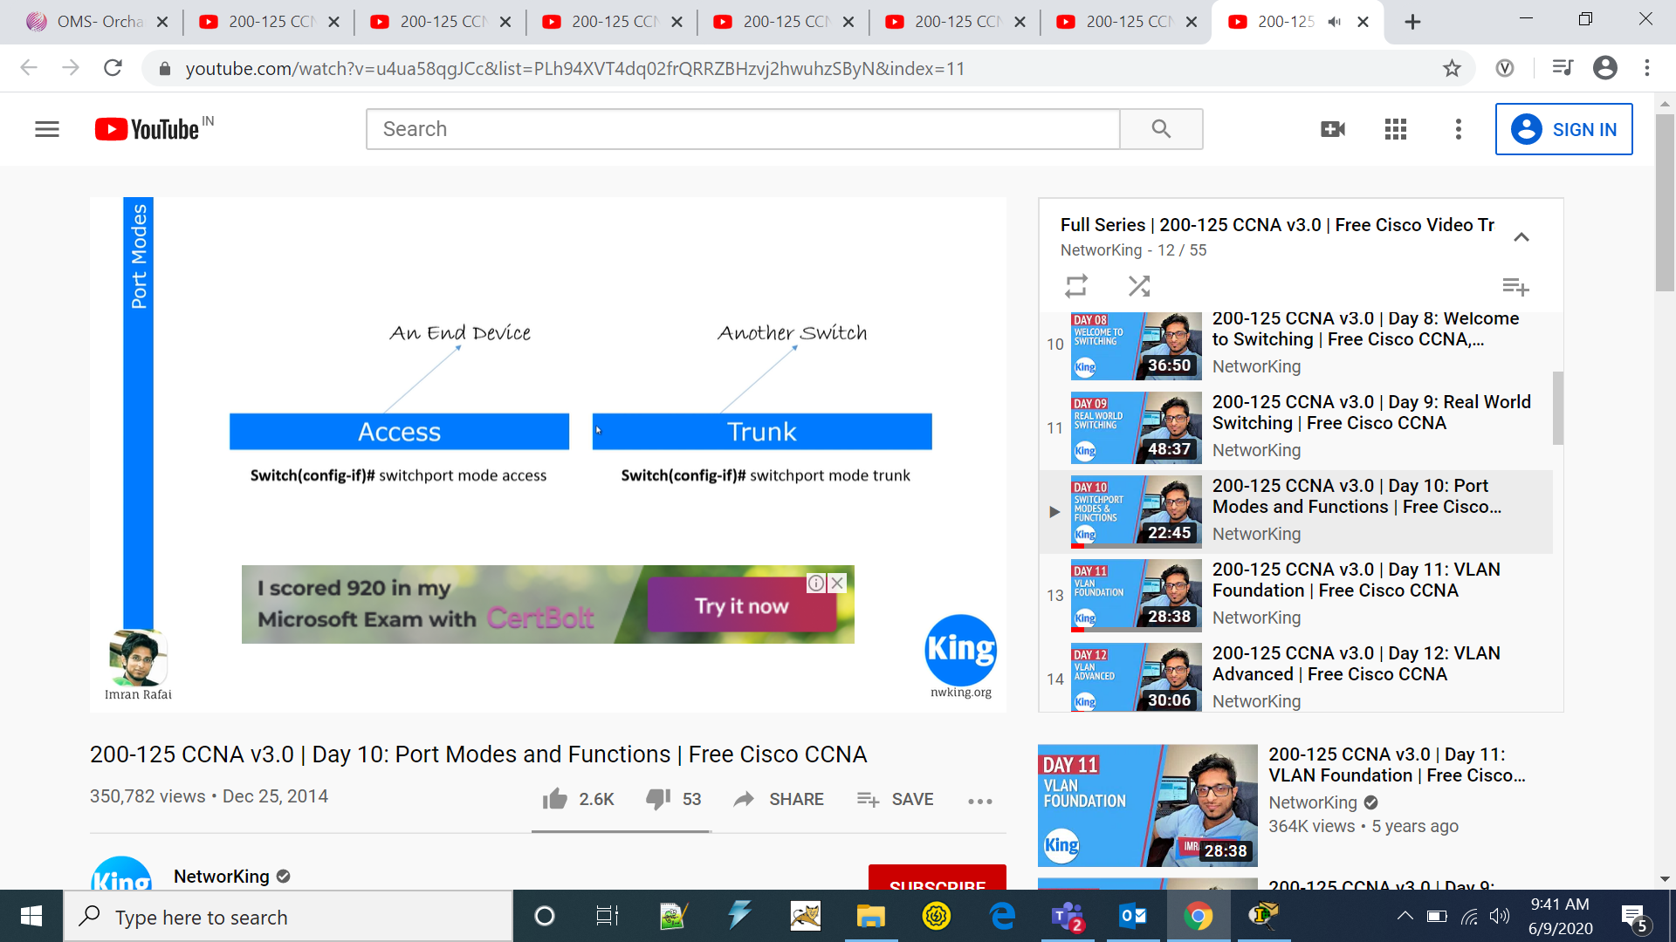
SWITCH PORT MODES

Slide 4
Access ports
This switch ports belongs to carry the traffic of only one vlan. By default, it will carry the traffic of native vlan (VLAN 1) .If the switch ports are assigned as access ports then it can be considered as the switch ports belongs to a single broadcast domain. Any traffic arriving on these switch ports are considered as it belongs to the VLAN assigned to the port.

Slide 5
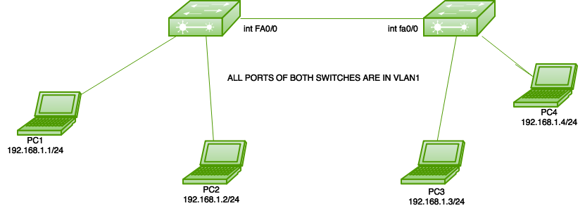
Here is a simple topology in which 2 switches are connected and only the default VLAN (VLAN 1)is configured on both switches i.e all the switch ports of both switches belongs to single broadcast domain.

Slide 6
Trunk ports
A trunk port is a specific type of port on a network switch that allows data to flow across a network node for multiple virtual local area networks or VLANs. Think of the trunk port as a “bundle” of individual branches or capillaries in a telecom network connection.

Slide 7
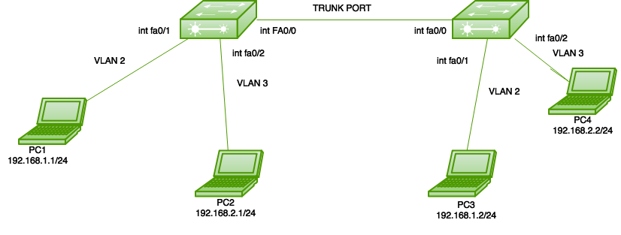
Here is a simple topology in which 2 switches are connected and VLANs 2 and 3 are configured on both switches .

Slide 8
Dynamic Trunking Protocol
The Dynamic Trunking Protocol (DTP) is used to negotiate forming a trunk between two Cisco devices. DTP causes increased traffic, and is enabled by default, but may be disabled.
DTP is a Cisco proprietary protocol that is automatically enabled on Catalyst 2960 and Catalyst 3560 Series switches. Switches from other vendors do not support DTP. DTP manages trunk negotiation only if the port on the neighbor switch is configured in a trunk mode that supports DTP.

Slide 9
Modes in DTP
Dynamic Desirable mode can start the DTP negotiation
Dynamic Auto
Dynamic auto mode can listen or reply to negotiation
Dynamic Desirable

Slide 10
Dynamic Desirable
A switch port configured as DTP dynamic desirable mode will actively try to convert the link to a trunk link using Dynamic Trunking Protocol (DTP). If the port connected to other port is capable to form a trunk, a trunk link will be formed.
The interface which is configured as DTP dynamic desirable mode will generate DTP messages on the interface. If the switch receive DTP messages from the other side switch, it will assume that other side port is capable for handling tagged frames and a trunk link will be formed between two switches.

Slide 11
Dynamic Auto
A switch port configured as DTP dynamic auto is capable to form trunk link if the other side switch interface is configured to form a trunk interface and can negotiate with trunk using DTP.
A switch interface which is configured as DTP "dynamic auto" mode will not generate DTP messages on the interface. DTP "dynamic auto" interface will only listen passively for DTP messages from other side switch's interface. If the DTP dynamic auto interface receives a DTP message from the interface of the other side switch, a trunk link will be formed.

Slide 12
SWITCH function
The SWITCH function evaluates one value (called the expression) against a list of values, and returns the result corresponding to the first matching value. If there is no match, an optional default value may be returned.

Slide 13
Types of Switch Functions
Address Learning
Forwarding Decision
Loop Avoidance

Slide 14
Address Learning
The switch learns the MAC address of the device on the switch port on which it receives the frame.

Slide 15
Forwarding Decision
The switch does 2 types of message forwarding: (a) Unicast: The switch unicast the frame to the destination only when it has an entry for destination MAC address in its MAC address table. (b) Unknown Unicast: When a switch receives a unicast frame for a destination for which switch has no entry in its MAC table then the switch simply broadcast the frame through all ports. This is known as flooding.

Slide 16
Loop Avoidance
For redundancy, two switches are connected to each other through two links which can also result in layer 2 loops. These loops are avoided by switch by using STP(Spanning tree protocol) protocol.

Slide 17
Spanning Tree Protocol
Spanning Tree Protocol (STP) is a link management protocol that provides path redundancy while preventing undesirable loops in the network. When it comes to ethernet networks, only one active path can exist between two stations in order for them to function properly. Loops occur in networks for a variety of reasons. The most common reason you find loops in networks is from trying to provide multiple levels of redundancy.

Slide 18
When having multiple root switches in a network used to provide this redundancy, the problem that arises is infinite loops between the switches and the end workstations they’re connected to. If a loop exists in the network topology, the potential exists for duplication of messages. When loops occur, some switches see stations appear on both sides of the switch. This confuses the forwarding algorithm and allows duplicate frames to be forwarded.
STP prevents loops by blocking one or more of the links. If one of the links in use goes down, then it would fail over to a previously blocked link.

Slide 19
VLAN (virtual LAN)
A virtual local area network (VLAN) is a logical group of workstations, servers and network devices that appear to be on the same LAN despite their geographical distribution.
A VLAN allows a network of computers and users to communicate in a simulated environment as if they exist in a single LAN and are sharing a single broadcast and multicast domain.
VLANs are implemented to achieve scalability, security and ease of network management and can quickly adapt to changes in network requirements and relocation of workstations and server nodes.

Slide 20
Why use VLAN's?
Allowing network administrators to apply additional security to network communication
Making expansion and relocation of a network or a network device easier
Providing flexibility because administrators are able to configure in a centralized environment while the devices might be located in different geographical locations
Decreasing the latency and traffic load on the network and the network devices, offering increased performance

Slide 21
Trunk Communication
A trunk is a communications line or link designed to carry multiple signals simultaneously to provide network access between two points. Trunks typically connect switching centers in a communications system. The signals can convey any type of communications data. A trunk can consist of multiple wires, cables or fiber optic strands bundled together to maximize the available bandwidth in a single physical cable, or it can consist of a single high-capacity link over which many signals are multiplexed.

Slide 22
VLAN Trunking Protocol (VTP)
VLAN Trunking Protocol (VTP) is a Cisco proprietary protocol that propagates the definition of Virtual Local Area Networks (VLAN) on the whole local area network. To do this, VTP carries VLAN information to all the switches in a VTP domain. VTP advertisements can be sent over 802.1Q, and ISL trunks.

Slide 23
What is VTP Pruning?
VLAN Trunking Protocol (VTP) pruning is a feature in Cisco switches, which stops VLAN update information traffic from being sent down trunk links if the updates are not needed. If the VLAN traffic is needed later, VLAN Trunking Protocol (VTP) will dynamically add the VLAN back to the trunk link.
VLAN Trunking Protocol (VTP) pruning helps in increasing the available bandwidth by reducing unnecessary flooded traffic. Broadcast frames, multicast frames, or unicast frames where the destination MAC address is unknown are forwarded over a trunk link only if the switch on the receiving end of the trunk link has ports in the source VLAN.

Slide 24
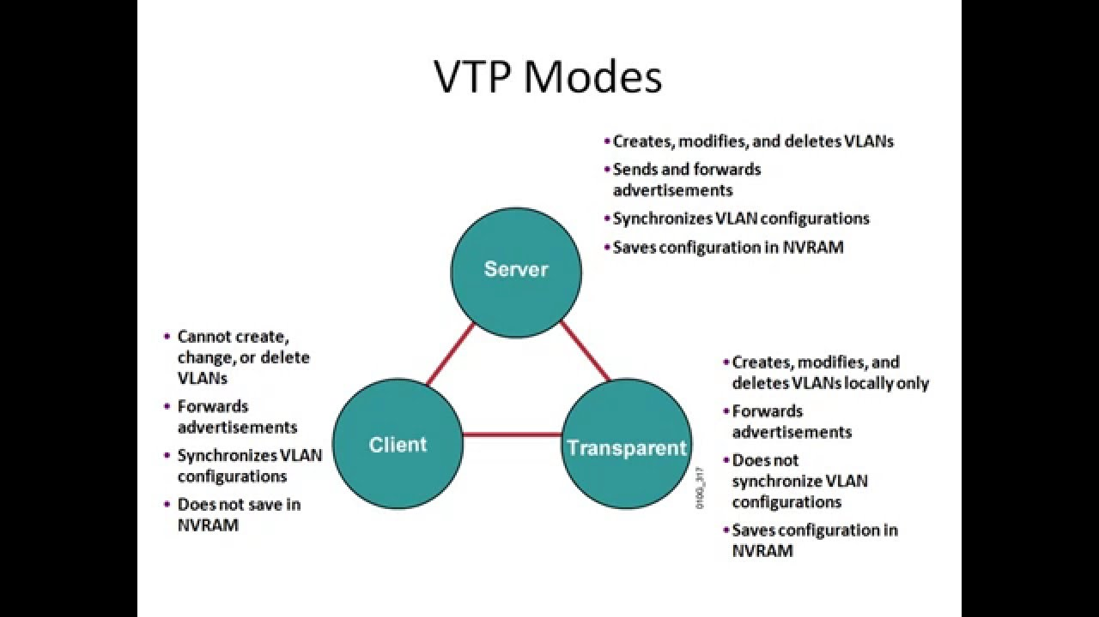
VTP modes

Slide 25
Slow connectivity
Reasons for slow connectivity:
Speed,Duplex

Slide 26
Port Security
It is used for security purpose of the ports in the switches.

